Slide 1
Writing Effective Feedback
!

Slide 2
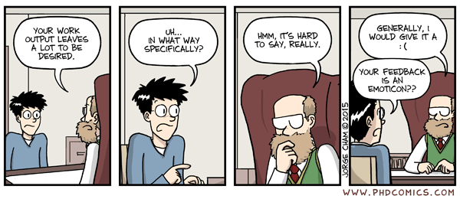
Why Do Effective Written Comments Matter?
INEFFECTIVE FEEDBACK
“Piled Higher and Deeper” by George Cham
Notes:
Feedback needs to be clear and specific in order for it to be helpful for the recipient, unlike in this comic
Effective written comments help instructors to interpret students’ numerical ratings on the Your Feedback questionnaires.
Providing written feedback gives insight into rating choice. They help instructors specifically identify what students value and would like to see continue, as well as where improvements might enhance teaching and courses.
Comments can also be used to suggest specific future changes to teaching or courses.
For this to happen, written comments need to clearly communicate how students’ individually experience instruction and courses.

Slide 3
Elements of Effective Written Feedback
Be Respectful
Provide positive and constructive feedback
Base feedback on your own perspective because it may be different than someone else’s
Instead of….
Try….
There were way too many readings in this class.
I was often unable to find time to complete all of the course work because it took me about six hours a week to complete the readings.
Notes:
Be Respectful: No one is inclined to listen to feedback when it’s insulting, rude, or threatening. Don’t make demeaning comments about race, gender, sexual orientation, religion, etc.
Provide Positive and Constructive Feedback: Reading only negative feedback can be overwhelming and disheartening. Be sure to tell instructors what you valued about the course and instruction as well.
Base Feedback on Your Own Perspective: Don’t assume that your perspectives and experiences are shared by everyone in the class. (before and after example)

Slide 4
Elements of Effective Feedback
Give examples
Instead of….
Try….
Love this instructor’s sense of humour!
I found the instructor’s sense of humour really engaging. The cartoons attached to the lecture slides helped me to remember different concepts.
Notes:
Specific examples let instructors know what you think they should or should not continue doing and why you found specific approaches to teaching helpful.

Slide 5
Elements of Effective Feedback
Explain how the instructor’s choices affected your learning experience
Instead of….
Try….
This online course isn’t very well organized.
This online course can be better organized. I submitted some work late because I couldn’t find the due dates or where I should access the necessary course resources for the assignments.
Notes:
Instructors need to know the outcomes of their teaching and course structure.
This is an opportunity for you to directly communicate how the course impacted your experience as a learner.

Slide 6
Elements of Effective Feedback
Make specific suggestions for change
Instead of….
Try….
Some assignments need to be dropped.
I really like the weekly journal reflections and think they’re important, but trying to finish a reflection when a second, major assignment was due was really stressful. Maybe there could be no journals on weeks with these larger assignments.
Notes:
Make specific suggestions for change rather than just pointing out an issue

Slide 7
Remember:
Be Respectful
Provide positive and constructive feedback
Base feedback on your own perspective
Give examples
Explain how the instructor’s choices affected your learning experience
Make specific suggestions for change

Slide 8
!
For more information visit: www.YourFeedback.uwo.ca

